Slide 1

Fit or Fail a revolutionary fitness game
Travis Stewart
Christian Sauls
Josh Shevitz

Slide 2
Purpose of The Game
Purpose
To create a fun, interactive learning experience that educates teens on consistent healthy lifestyle decisions such as diet and exercise
US Dept of Health and Human Services (DHHS) – “teens today are more likely to develop a sustained interest in a healthy, active lifestyle if they are provided with some type of technology-based “game-like” tool to stimulate their interest in the areas.“
Focus group: high school aged teens, eventually expanding to children of all ages
Primary platform: mobile

Slide 3
About Our Game
Online multiplayer trivia game
Game modes:
Simple trivia:
Solo – Play by yourself, answering a handful of randomly-chosen questions
Kahoot!-style trivia:
Online – Play for points competitively against other individuals
Users can create and join “Teams”
User accounts store data for cumulative points earned and total match victories
Users in a Team contribute their earnings to their Team’s statistics as well

Slide 4
Technologies Used
Front end:
HTML/CSS
JavaScript
React
Back end
MongoDB (NoSQL)
JavaScript
Express.js
mongoose.js
JSON Web Tokens
Domain/Hosting provider
name.com
DigitalOcean

Slide 5
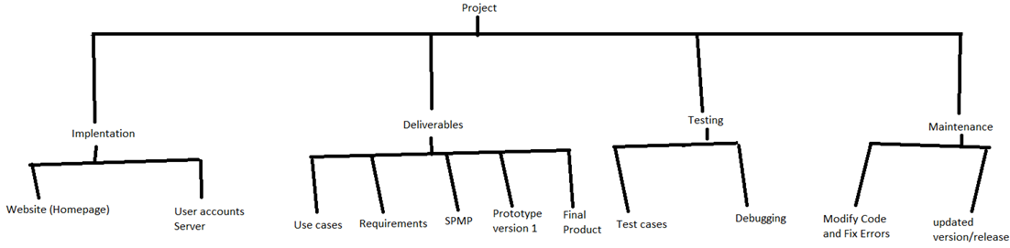
Work Breakdown Structure

Slide 6
Work Completion Timeline

Slide 7
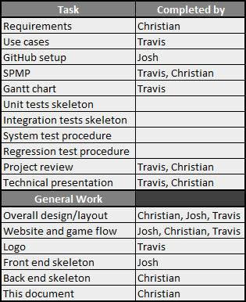
Completed Tasks

Slide 8
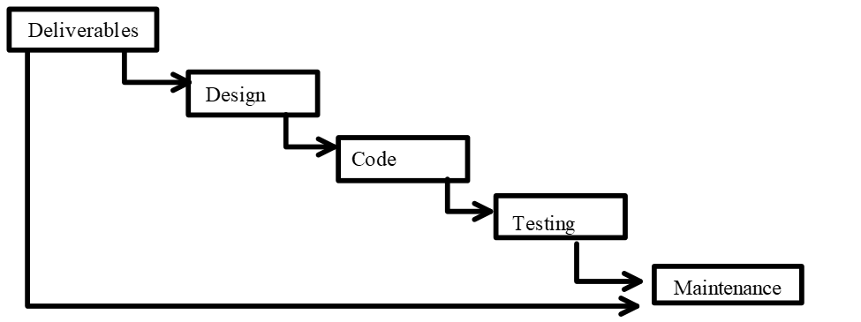
Process model
This project will be using the waterfall model
Has many phases/parts
Each part relies on the previous parts
Waterfall model parts (in order)
Requirements Analysis
Design
Implementation
Verification/Testing
Maintenance.

Slide 9
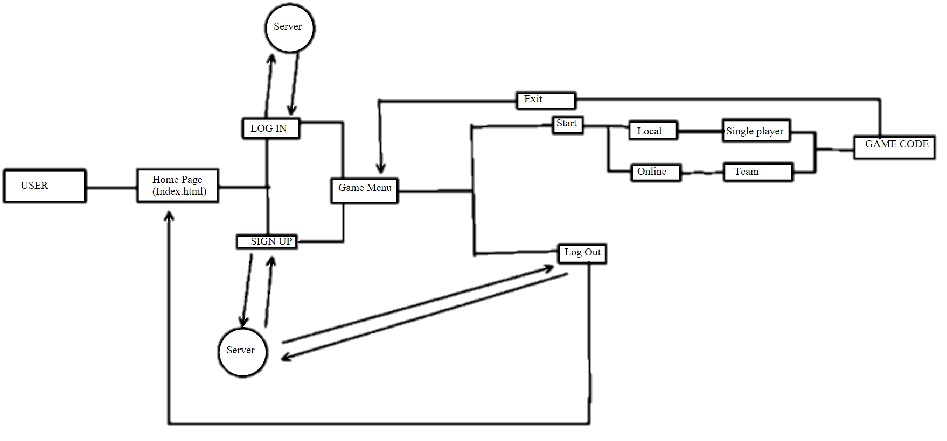
Website game layout

Slide 10
Current Working Prototype

Slide 11
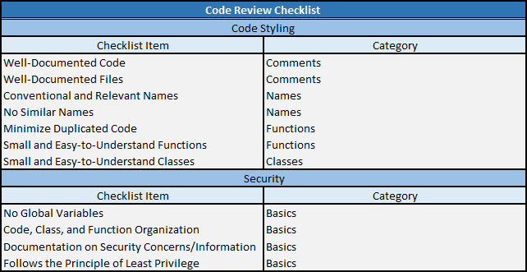
Project Review: I

Slide 12
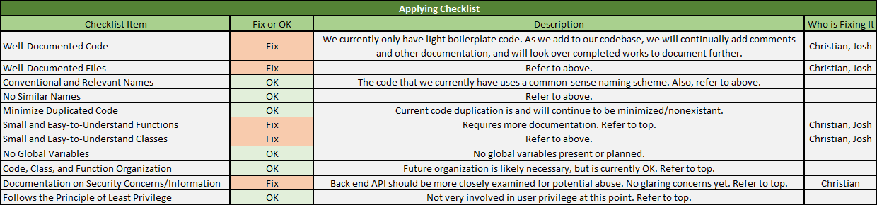
Project Review: II

Slide 13
Presentation todo
Put logo on title slide
Someone needs to first complete our logo
Update all our flow diagrams to represent our new flow
Prettify all diagrams
Please use an online app like https://lucidchart.com to make them so they look really nice
Add slides for all deliverables to date
I’ve compiled a list of all of them in DELIVERABLES_LIST.txt

